Slide 1
A Physical Diversity
Africa

Slide 2
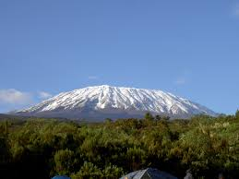
Mountains
Africa contains several mountain ranges like the Atlas mountains in the NW which are an extension of the European system and the Mitumba Mountains which are located on the West Side of the Rift Valley.
Mount Kilimanjaro located on the east side of the rift valley is the highest mountain in Africa. It was formerly an active volcano.

Slide 3
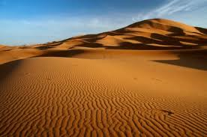
Deserts
The Sahara is the largest of Africa’s deserts.
It covers much of the northern part of the continent. It is expanding at a rate of 5 cm a year.
Smaller desert areas in the south include the Namib Desert and the Kalahari Desert.

Slide 4
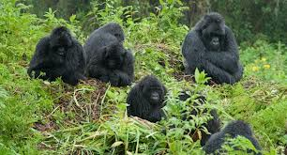
Rainforest/Jungle
The Congo basin area is home to some of the world’s most lush and tropical jungles.
The largest is the Ituri forest covering 2 900 sq km2 in the northern part of the Congo Basin.
The area is characterized by large amounts of rainfall and dense vegetation.

Slide 5
The Savannah
Def: a vast area of tropical and subtropical grassland
Covers more than 30% of the African Continent
Extends across the continent in two broad zones separated by tropical rain forest in Gabon and Congo.
The savannah harbours one of the richest populations of wildlife in the world.
The distribution of the trees depends largely on rainfall patterns. Annual precipitation can range from 1270mm to 250mm.

Slide 6
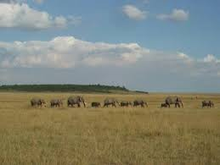
Savannah
Luxuriant coarse grasses up to 3m tall and patches of deciduous trees grow in the wettest areas. In the drier areas, grasses are shorter and trees fewer with some shrubs and bushes.
Trees and Shrubs in the drier Savannah are classified as XEROPHYTIC - which means drought resistant, such as the Acacia

Slide 7
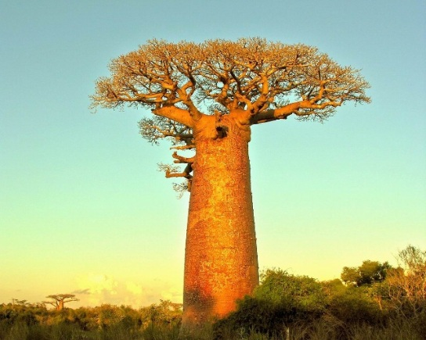
Savannah con’t
Savannah trees generally have small leaves to minimize water loss by TRANSPIRATION - the passage of water vapor through the leaves.
Trees such as the baobab store water in their trunks which can be massive. Some baobabs have a circumference of 9m.

Slide 8
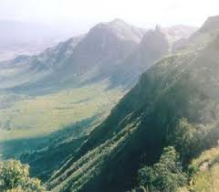
Rift Valley
Formed when two plates are moving apart and the centre drops between them.
Usually occurs in the ocean where plates are formed by rising magma.
Southern part of the rift valley contains volcanoes.
The Great Rift Valley is 60-100km wide & 2900km in Length

