Slide 1
Alternative Forms of Energy

Slide 2
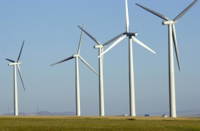
Wind
Wind energy harnesses the power of the wind to propel the blades of wind turbines. The rotation of turbine blades is converted into electrical current by means of an electrical generator

Slide 3
Positive vs Negative
Positive
Produces no pollution
It is a renewable source of energy.
Farming and grazing can still take place on land occupied by wind turbines
Wind farms can be built off-shore.
Negative
Wind is not consistent
Health problems (annoyance, stress, sleep disturbance, headache, anxiety, depression, and cognitive dysfunction. Some have also felt anger, grief, or a sense of injustice. Suggested causes of symptoms include a combination of wind turbine noise, infrasound, dirty electricity, ground current, and shadow flicker.)
Negative affect of the scenery

Slide 4
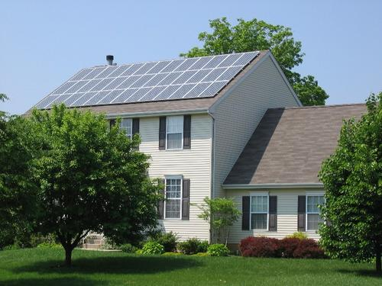
Solar
Solar energy works by trapping the sun's rays into solar cells where this sunlight is then converted into electricity

Slide 5
Rick Mercer – Solar Panels

Slide 6
How does various types of Alternative energy work?

Slide 7
Positive vs Negative
Positive
Renewable source of energy
No water or air pollution
Can be used for practical uses such as heating and lighting
Negative
Need consistent sunlight
Expensive to build

Slide 8
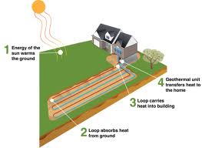
Geothermal
Geothermal energy harnesses the heat energy present underneath the Earth

Slide 9
Positive/Negative
Positive
No harmful by-product
Self sufficient energy use
No effect on the natural landscape
Negative
Drilling into the earth can release hazardous minerals and gases
Possibility of running out of steam

Slide 10
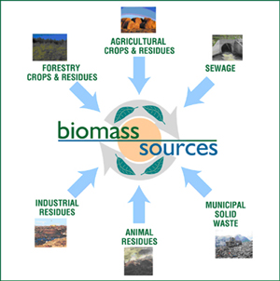
Biomass
Fuel that is extracted form organic resources such as; wood, corn, garbage, animal waste and forest floor items

Slide 11
Positive vs Negative
Positive
We always have a source
No emissions
1/3 the cost of coal or oil
Negative
Extraction of the energy is expensive
Areas needed for storing the energy are large

