Slide 1
Canada’s Population Distribution and Density
Where do Canadians live and why?

Slide 2
Canada’s Population Distribution
In terms of land area, Canada is the _2nd_ largest country in the world. However, our population is quite _low_ at ___35,344,962__ in 2014.

Slide 3
Population Distribution
Population Distribution: pattern or where people live
More than 90% of all Canadians live within 600Km of the US border. The remaining 10% are scattered throughout the rest of the country.
There are __3___ main types of population distribution patterns:_dispersed, linear and concentrated. _.

Slide 4
Types of Population Distribution
Dispersed Linear Concentrated
(farming) ( along water) (natural resource or a hwy) based)

Slide 5
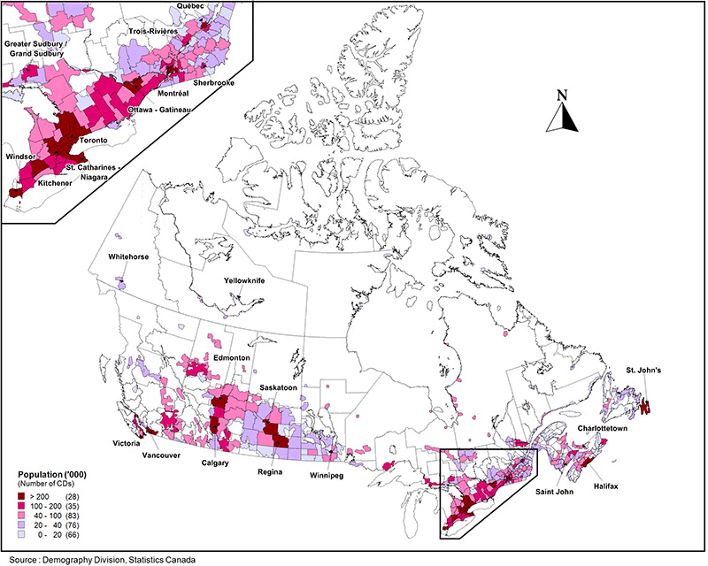

Slide 6
5 Factors that affect Canada’s population distribution
Nearness to water – drinking, transportation & recreation
Warmer climate – warm summers & cold winters
Relatively flat (housing, industry roads)and fertile land (agriculture)
Near existing cities for employment
Close to the USA for economic trade.

Slide 7
Population Density
Population Density is _the _number of people per square kilometer

Slide 8
2 types of density
A locale example of an area with a high population density would be _dense (i.e... Activa)___ and an area with a low population density would be __sparse (i.e. Preston).
HIGH LOW

Slide 9
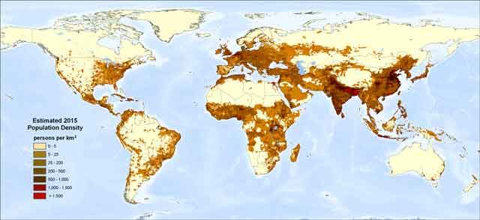
World Population Density Map

Slide 10
Population Density Formula
Formula
population
__________
Area (sq/km)
Example
43,000,000
1, 320, 400
= 32.6 people per square kilometer

Slide 11
Making Predictions
Canada has a population density of 3.7 ppl/km2.
More than 90% of all Canadians live within 600Km of the US border. The remaining 10% are scattered throughout the rest of the country.

