Slide 1
Canadians Abroad
What to know before you travel…

Slide 2
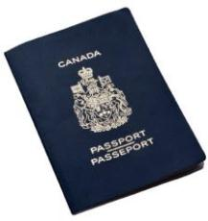
Passports
A passport is the only reliable and universally accepted travel identification document, it proves that you have a right to return to Canada.
Good for 5 or 10 years.
Most countries require your passport to be valid for 3-6 months beyond your departure date.
Damage passports must be replaced immediately.
Recommended that your scan or photocopy your passport and email it to yourself or up load it to the cloud.

Slide 3
Passports
https://www.youtube.com/watch?v=AJ0NL3fE6uk

Slide 4
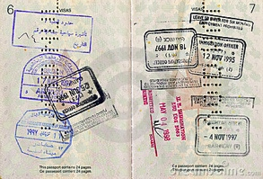
Visas
A visa is an official document, usually stamped or glued inside a passport, giving permission from a foreign authority for you to enter a country.
Requirements, fees and processing times vary, depending on the country and type of visa you need.
The most common categories are business, work, student and tourist visas.
Many countries require visas for entry or for extended stays. In most countries this is 90 days.
Check voyage.gc.ca to know whether you need a visa and get it well in advance of your trip.

Slide 5
Travel Insurance
OHIP (Ontario Health Insurance Program) does not cover you outside of Canada including the USA.
Your travel insurance should include health, life and disability coverage that will help you avoid large expenses, such as the cost of hospitalization or medical treatment outside Canada.
If a Travel Advisory has been issued for that country, your insurance may not be valid.
If you are flying, being insured for flight cancellation, trip interruption, lost luggage and document replacement will save you from major disruptions and additional costs.
If you are travelling by car, make sure you have driver and vehicle coverage in case you have an accident abroad.

Slide 6
Immunization & Vaccines
When travelling abroad, you may be at risk for a number of illnesses that can be prevented by vaccination (ie. Measles, polio, flu, Hepatitis A&B)
Some countries require proof of yellow fever vaccination in the past 10 years.
In regards to Malaria (a common and deadly tropical disease) there is no vaccine. To prevent Malaria protect yourself against mosquito bites and take anti-malaria medication.

Slide 7
Immunization & Vaccines
Centre for Disease Control (CDC.org)
Travel & Health: Disease Prevention

Slide 8
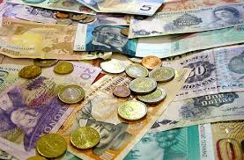
Money
Canadian currency and traveller’s cheques are rarely accepted abroad.
Before you leave Canada, consult a bank or foreign currency agent to find out the most appropriate currency to carry.
It is always a good idea to have a small amount of local currency on hand when you arrive,
Check currency regulations with your travel agent or the country’s embassy or consulate in Canada.
Be aware that your debit or credit card may not be accepted abroad. Check with your bank for information on ATM services in other countries.
Before departure, make arrangements to obtain additional funds if needed.

Slide 9
Foreign Laws
Familiarize yourself with the way of life. Respect that country’s laws, religions, culture, class structure and economic conditions. Although you may not agree with some of the country’s beliefs, remember that you are a visitor.
Respect local dress codes. In many countries, appropriate attire for both sexes is very important and may even be legislated. Penalties for disobeying local laws can be severe.

Slide 10
Medications/Drugs and Travelling…

Slide 11
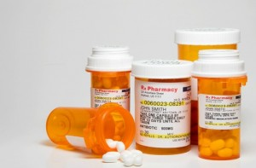
Do’s
Find out if your prescription medications are legal in the countries your planning to visit.
Pack your luggage yourself and never leave it unattended.
Keep an eye on your child’s backpack, toys and stuffed animals.
Find out if certain areas are unsafe so you are not suddenly in the wrong place at the wrong time.

Slide 12
Don’t….
Be fouled into smuggling drugs in exchange for money or a free vacation.
Carry parcels, gifts or luggage for other people across borders through customs under ANY circumstances.
Give into the temptation to use drugs. Different countries have different laws regards drugs.

Slide 13
Drugs and Travel - Beware
Canadians can get into trouble for buying, selling, using or transporting drugs.
You are subject to the laws of the country you are in, not Canadian law.
Some people smuggle drugs to earn some quick cash, but may face heavy fines, jail time or the death penalty.
Most traffickers prey on women or young travellers.
In some countries you can be charged with being with a person suspected or a crime.

Slide 14
Canadian Consular
In 150 countries worldwide, Foreign Affairs, Trade and Development Canada is ready to assist Canadians travelling, working, studying or living abroad.
The following list includes some examples of consular services (see travel.gc.ca/ services offered for a more complete list). Note that you may have to pay costs associated with some of these services.
Services offered by consular officials IN EMERGENCIES
Help in a medical emergency by providing you with a list of local doctors and hospitals.
Help arrange for a medical evacuation if a necessary treatment is not available locally.
Provide advice and contact information on local police and medical services to victims of robbery, sexual assault or other violence.
Provide assistance in cases of missing persons or the abduction of a child to another country.

Slide 15
WHEN LEGAL ISSUES ARISE
Provide you with a list of local lawyers and information about local laws and regulations.
Seek to ensure you are treated fairly under a country’s laws if you are arrested or detained.
Notarize certain documents.
Obtain a criminal record check on your behalf.
Investigate a crime or death.

Slide 16
WHEN OTHER ISSUES ARISE
Replace a lost, stolen, damaged or expired passport.
Contact relatives or friends to request assistance in sending you money or airline tickets.
Transfer funds if urgent financial assistance is required.
Contact next of kin, with your authorization, if you have had an accident or are detained by police.
Provide advice about burying a Canadian abroad or assist in repatriating the remains to Canada.
Advise local police in Canada to contact next of kin in case of death.
Request that local authorities investigate suspicious circumstances in the event of an alleged or apparent crime or death

Slide 17
Make a travellers checklist…
Using all of the information discussed create your own personal travel checklist
This will be something you should check before you travel!
MUST have at least 10 items!!!
Example:
Valid Passport

