Slide 1
Factors Affecting Urban Land use

Slide 2
Land Value
Highest in areas of the city that most “accessible”
CBD (so…..high building)
Along major transportation routes
New housing developments now have smaller lots
Activa vs Laurentian

Slide 3
Zoning bylaws
Laws
Usually passed by city governments
Control kind and amount of development in an area
Helps to avoid conflict

Slide 4
Climate
Winter-city concept
Buildings that are “Livable” during winter and summer
i.e. underground walkways, malls

Slide 5
Technology
Widespread use of the automobile after WWII changed urban areas
Wider arterial roads
Local roads designed to slow traffic
Large parking lots
Suburban sprawl

Slide 6
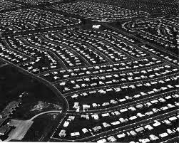
Los Angelos

Slide 7
