Slide 1
International Time Zones

Slide 2
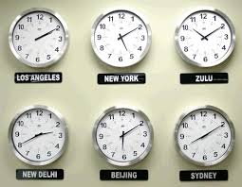
Longitude and Time Zones
There are 24 time zones, with 1 hour difference between them.
Each time zone is 15 degrees (360/24 = 15)
Every place within a zone has the same time = standard time
It was developed by Sir Sandford Flemming, a Scottish Born Canadian.

Slide 3
Prime Meridian
Centre of time zones, 0 degrees longitude
This is called ‘Greenwich Time (GMT) and all others are compared to it.
WEST of the Prime Meridian, zones are behind time (subtract); Toronto is 5 zones to the west of GMT so we are 5 hours behind GMT
EAST of the Prime Meridian, zones are ahead of time (add); Moscow is 2 zones to the west, therefore they are 2 hours ahead of GMT
Countries may modify the zones for political reasons

Slide 4
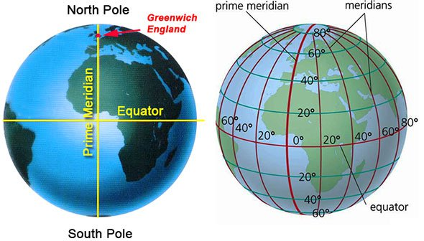

Slide 5
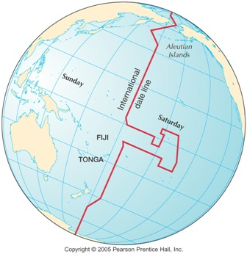
International Date LIne
A longitudinal line that follows the 180 degree line through the Pacific Ocean, therefore not passing through any major land masses.
If you cross it moving westward, you add a day
If you cross it moving eastward, you lose a day

Slide 6
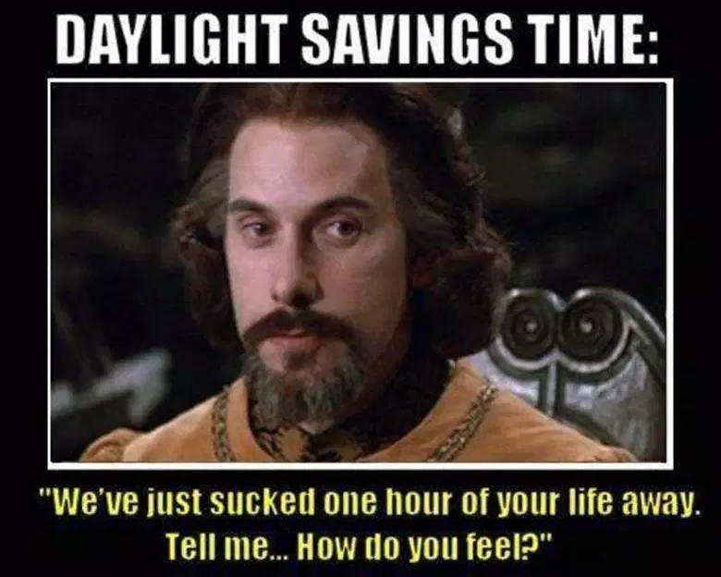
Daylight savings
Countries change time according to the season (fall - back, spring - forward)
During the summer ‘Daylight Savings’ is used to extend the daylight hours into the evening when most people are awake.
Not all countries use Daylight Savings
Movie Trailer

Slide 7
Videos
International Time Zones
Jet Lag

