Slide 1
Personality & Travel

Slide 2
Psychocentric Travellers
Psychocentric travellers prefer familiar travel, where activities, schedules and surroundings are consistent and lack surprises.
Examples:
Canada’s Wonderland
Niagara Falls
Rogers Centre

Slide 3
Psychocentric cont.
Characterized by
Prefer the tour package
Not highly active
Prefer common place activities (ie sun, sand and surf)
Drive rather than fly
Prefer a familiar tourist destination with accommodations, shops etc similar to those at home
Don’t want a ‘foreign’ atmosphere
Comfortable being around other tourists
Prefer to have all the travel arrangements made for them
Non-risk takers

Slide 4
Psychocentric cont.
What types of Tourism do you think psychocentric travelers prefer?
Social
Recreation
Sports
Business

Slide 5
Midcentric Travellers
Midcentric travellers travel to obtain a break in routine. They usually like variety without being too exotic.
Examples
Florida
Hawaii
Europe
South Africa

Slide 6
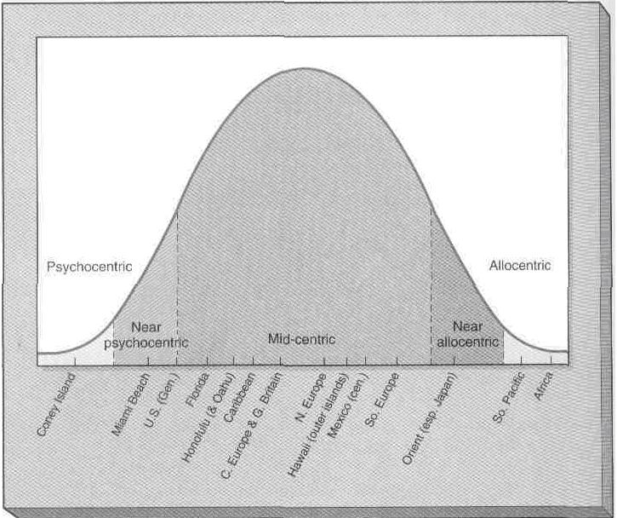
Plog

Slide 7
Midcentric cont.
Characterized by:
Preference for controlled environments
Willing to take risks
Curiosity about new surroundings yet require some planned activities

Slide 8
Midcentric cont
What type of tourism do you think Midcentric travellers prefer?
Recreation
Sports
Social
Nature
religious

Slide 9
Allocentric Travelers
Allocentric travelers view travel as a way of expressing inquisitiveness and curiousity.
They want to see and do new things and explore the world to the best of their ability.
They enjoy adventure and risk taking.
Examples
India
Mainland Africa
Middle East
Antartictica
South East Asia

Slide 10
Allocentric Travelers
Characterized by:
Adventuresome and like to explore alone or in small groups
Enjoys new experiences and discovery
Seeks different destinations before others have been there
High activity levels
Prefer areas that are not ‘touristy’
Will accept basic conveniences in accommodations and food
Enjoy meeting and dealing with people from another country or culture

Slide 11
Allocentric Travellers
What types of Tourism do you think Allocentric Travellers prefer?
Active
Adventure
Wilderness
Nature
Cultural
Ecotourism

