Slide 1
Environmental Threats
Ecosystems in Crisis…Tourism in Crisis

Slide 2
Threats
Brainstorm a list of natural and human threats to the environment. Think specifically of the Savannah region.
Notes:
- May want to have students list “
- Make a wordle as a class and then post it.

Slide 3
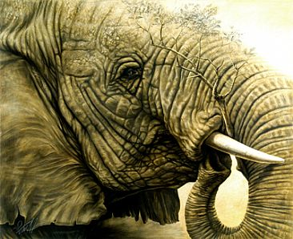
POACHING
East Africa’s Persistent Problem

Slide 4
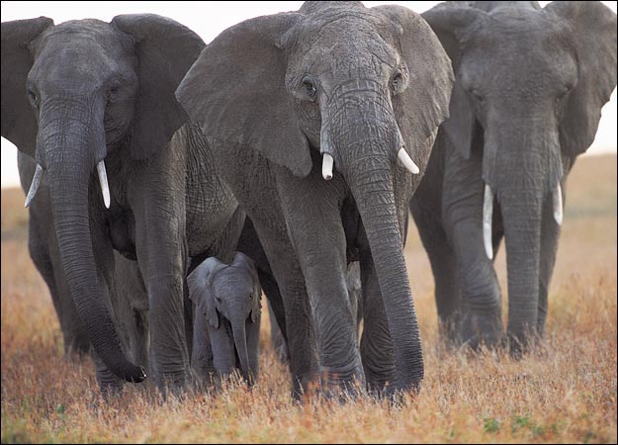
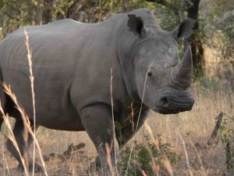
What is Poaching?
Illegal hunting or trapping of wildlife for food or profit
Elephants and black rhinos most common

Slide 5
Adult African Elephants are prized by poachers for their ivory in their tusks. Trade in Ivory is not illegal throughout the world.
Nonetheless, criminal/terrorist organizations continue to sell ivory, primarily to markets in East Asia.

Slide 6
Current Numbers
Black Rhino – down 98% since 1960
Mountain Gorilla – fewer than 900 remaining
African Elephant – 35 000 killed last year
Lion – extinct in 7 South African countries
Grevy’s Zebra – approx. 2000 remaining

Slide 7
Why they are being killed?
Rhino
believed to cure: hangovers, impotence, fever & cancer. None have been proven to cure.
Demand for a Rhino Horn is extremely high. A pound will go for $30 000 (vs a pound of gold is worth $2000)
Elephant Ivory
Jewelry, trinkets, utensils & religious figures.
70% of ivory is sold to China, where it has a value of $1000 per pound

Slide 8
Why are they being killed?
Zebras
They are hunted for their skin and occasionally their meat
Gorillas
Increase in infant gorilla trafficking. Can be worth up to $40 000
Lions
due to increase habitat loss, many lions live near humans.
They are being killed by farmers as retaliation for preying on livestock

Slide 9
In the media…
White Gold
Caution: Some sensitive content
Notes:
WARNING: Some viewers may be sensitive to some of the content.

Slide 10
Fast Fact Recap
KENYA
Life Expectancy 63 GDP/capita $1,700 Literacy 87%
Doctors 0.13/1000
TANZANIA
Life Expectancy 53
GDP/capita $1,600 Literacy 69%
Doctors 0.008/1000

Slide 11
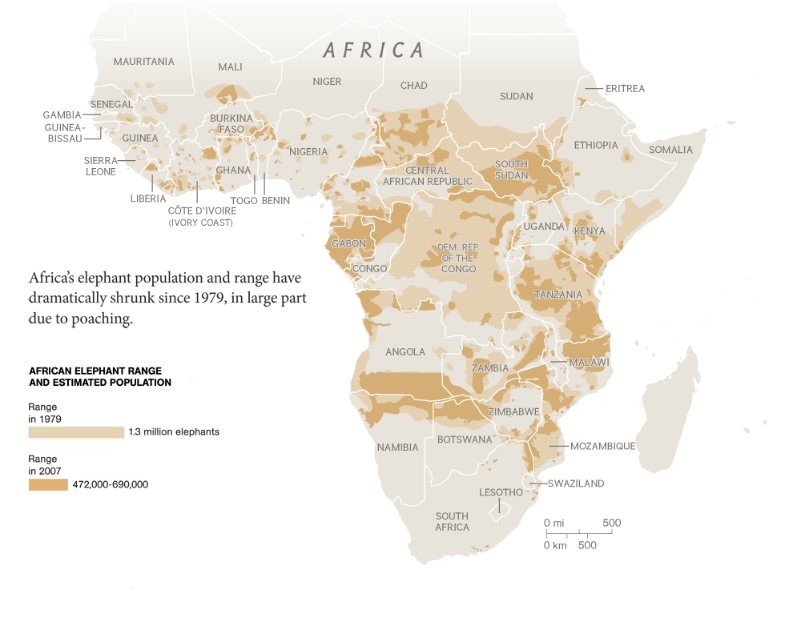

Slide 12
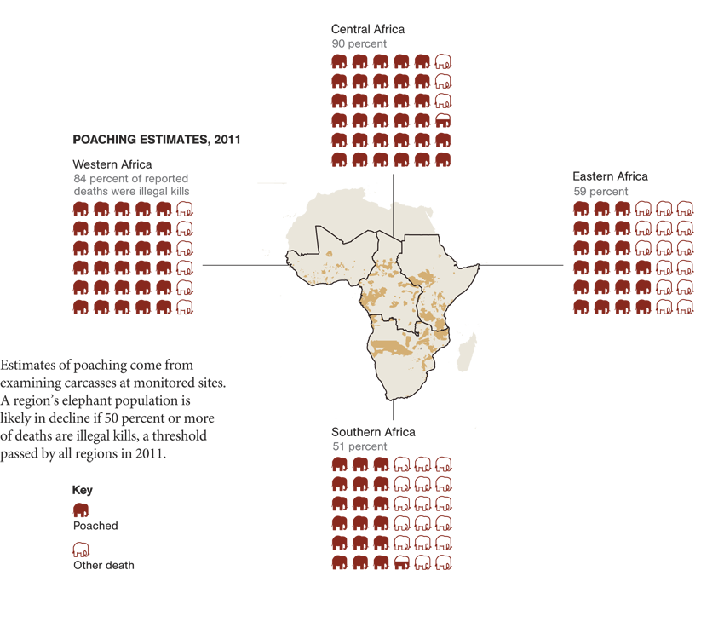

Slide 13
Convention on International Trade in Endangered Species (CITES): International agreement between governments to ensure that the trade in specimens of wild animals and plants doesn’t threaten their survival.
Vision 2030: Kenya’s national project to improve the economy and overall development.
Kenya Wildlife Service (KWS): Organization responsible for managing and protecting Kenya’s wildlife

Slide 14
5WsH
In your notebook, create an organizer like that on the board
Read the article provided and complete your organizer to understand the dynamics of the poaching industry in East Africa
Keep track of all new vocabulary terms

Slide 15
Poaching in the news…
Tanzania main port for Asian markets
China’s Ivory Trade Revival
China’s growing demand

Slide 16
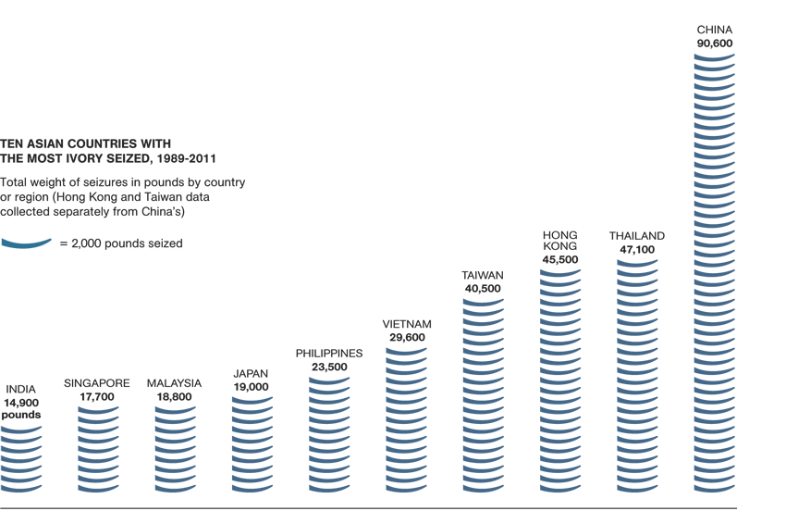
Each tusk icon represents 90 elephants, based on a tusk weight of 11 pounds, used to help calculate poaching levels. For comparison, the tusk at left is 12.2 pounds.

Slide 17
What is being done?
Political Responses
Taking a symbolic stand
Stricter conservation policies and implementation
Stricter laws and enforcement
Economic Responses
Trade boycotts
Increased fines for poachers
More government spending on conservation and enforcement

Slide 18
What is being done?
Social Responses
Education! Wildlife = Tourism = Income!
Social marketing to change demand
Environmental Responses
GPS tracking devices on animals
NGOs (eg. WWF) and global organizations like CITES working on conservation

Slide 19
Challenges
Knowing about the standard of living in East Africa, what challenges are there in trying to address this issue?
High levels of poverty and few job opportunities makes poaching attractive
Global demand = available market
Lack of sufficient money for enforcement
Government corruption
Lacks of conservation funds
Low levels of education = ignorance about impacts

