Slide 1
The Great Barrier Reef

Slide 2
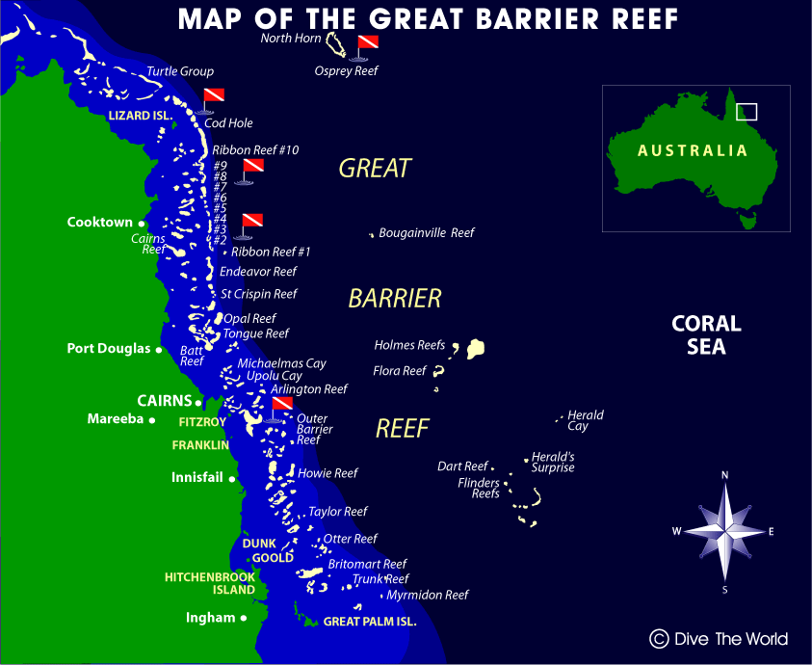

Slide 3
http://www.youtube.com/watch?v=kRoC3yKVGCk

Slide 4
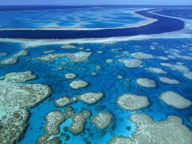

Slide 5
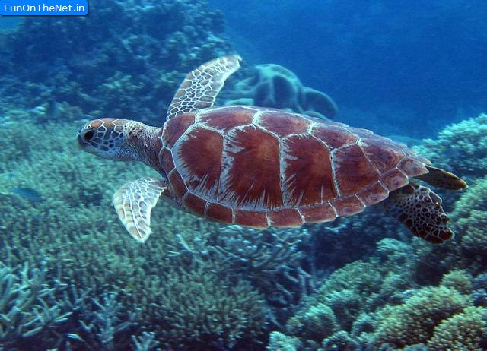

Slide 6
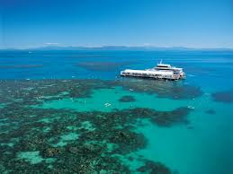

Slide 7
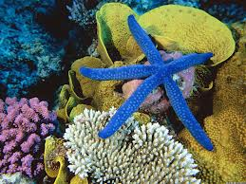

Slide 8
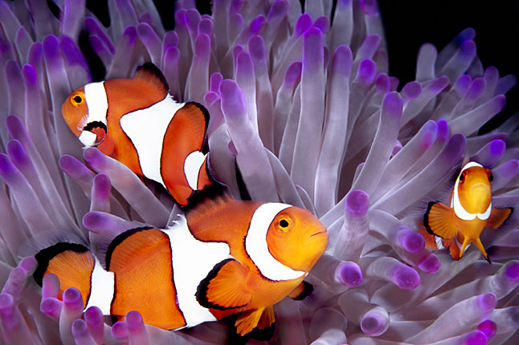

Slide 9
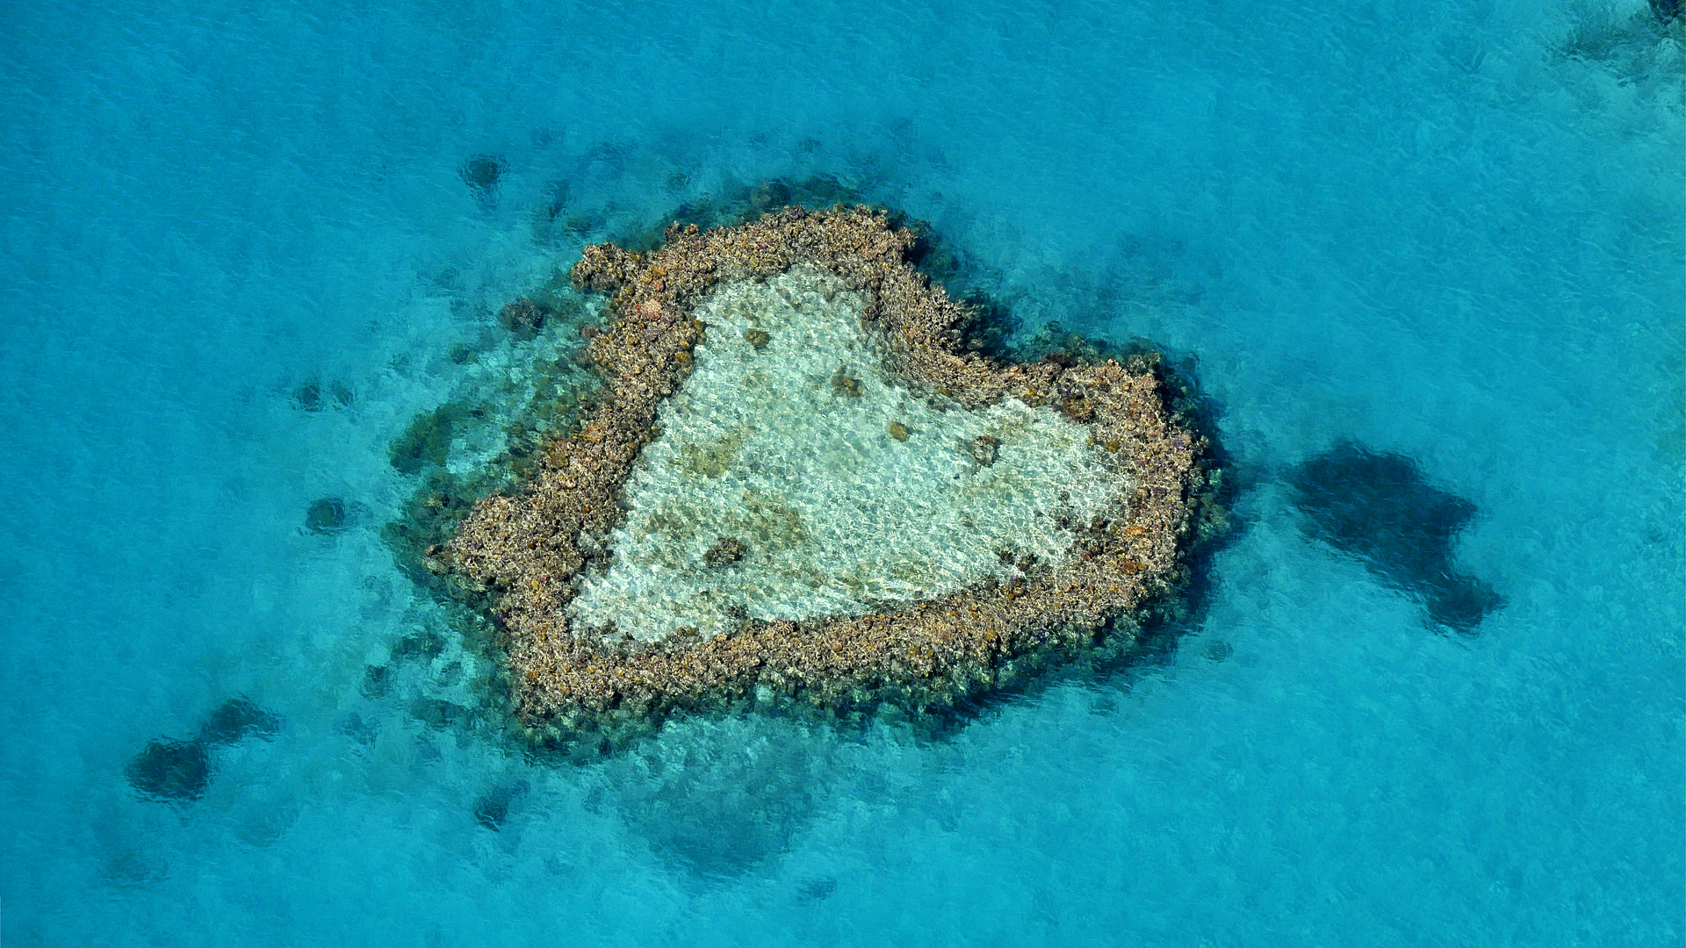

Slide 10
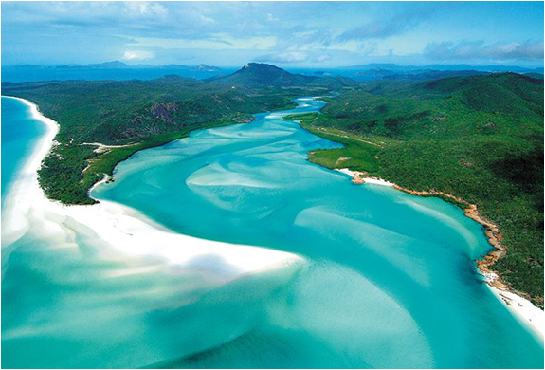
The Great Barrier Reef is one of the seven wonders of the natural world.
It is larger than the Great Wall of China and the only living thing on earth visible from space.

Slide 11
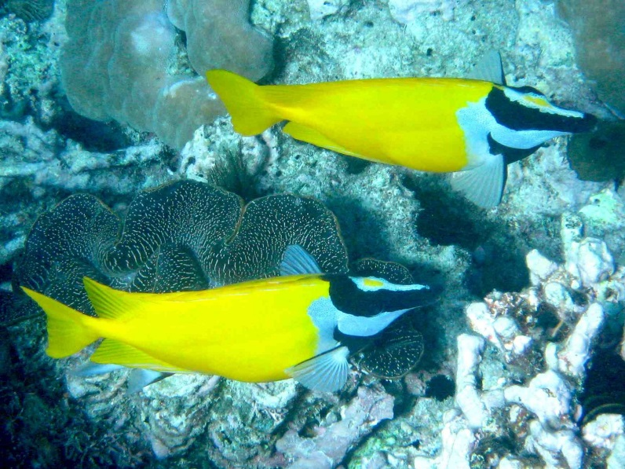
Where Is The Great Barrier Reef?
The marine park stretches over 3000km almost parallel to the Queensland coast, from near the coastal town of Bundaberg, up past the tip of Cape York.
The reef is a gathering of brilliant, vivid coral providing divers with the most spectacular underwater experience imaginable.

Slide 12
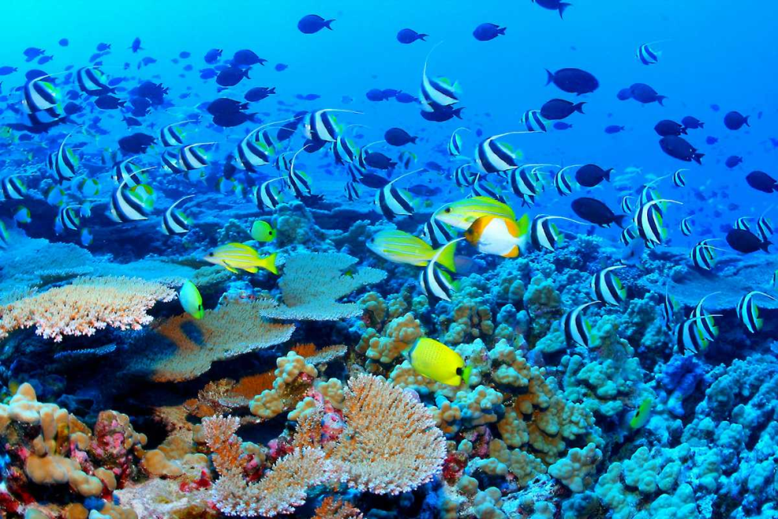
A closer encounter with the Great Barrier Reef's impressive coral gardens reveals many astounding underwater attractions including the world's largest collection of corals (in fact, more than 400 different kinds of coral)

Slide 13
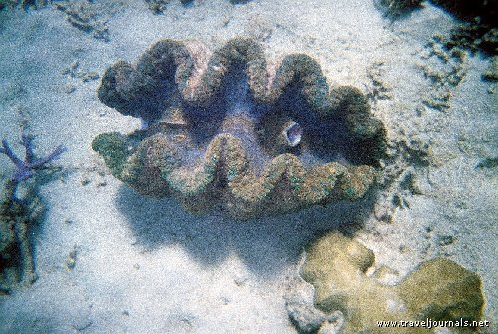
Also has:
Coral sponges
Molluscs
Rays
Dolphins
Over 1500 species of tropical fish
More than 200 types of birds
Around 20 types of reptiles including sea turtles
Giant clams over 120 years old

Slide 14
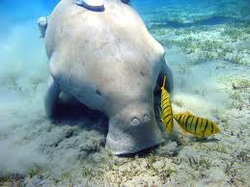
What Is The Great Barrier Reef?
The Great Barrier Reef is a breeding area for humpback whales, migrating from the Antarctic and is also the habitat of a few endangered species including the Dugong (Sea Cow) and large Green Sea Turtle. In recognition of its significance, UNESCO listed the Great Barrier Reef as a World Heritage Site in 1981.

Slide 15
Tourism
Because of its natural beauty, both below and above the water's surface, the Great Barrier Reef has become one of the worlds most sought after tourist destinations.
In 2006 there were approximately 820 operators and 1500 vessels and aircraft permitted to operate in the Great Barrier Reef Marine Park providing ease of access for all to experience the Great Barrier Reef and learn first hand about its natural delights and World Heritage values.

Slide 16
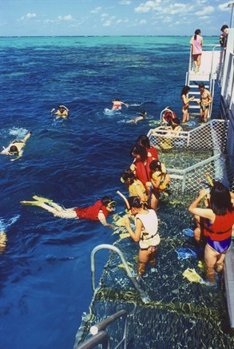
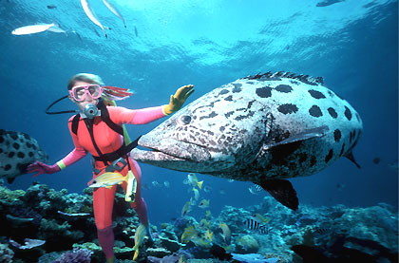
Tourism Activities
Scuba diving
Snorkeling
Sailing

Slide 17
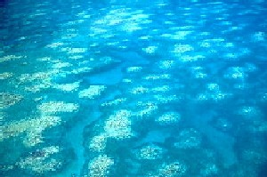
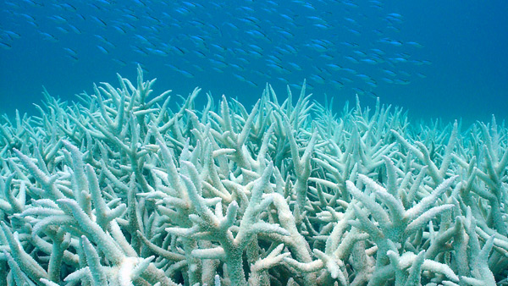
Environmental Impacts
Climate Change: mass coral bleaching is caused by warming waters. This causes diseases to enter the reef and kill the coral.

Slide 18
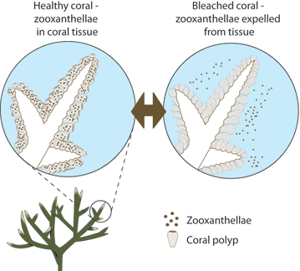

Slide 19
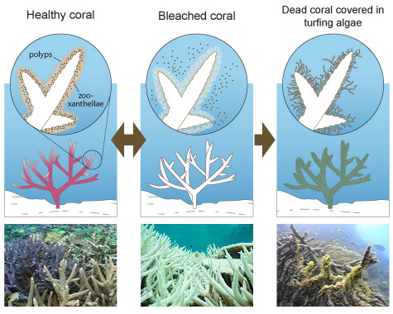

Slide 20
Pollution: Runoff from fertilizers on land, entering the water. Wetlands have been decreasing and 90% of pollution comes from runoff.

Slide 21
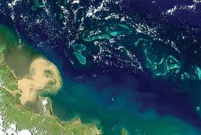

Slide 22
Quick Facts
Fact: The Great Barrier Reef is the world's largest reef system
Fact: The Great Barrier Reef is composed of over 2,900 individual reef
Fact: The Great Barrier Reef has over 900 islands stretching for over 2,600 kilometres
Fact: The Great Barrier Reef can be seen from outer space

Slide 23
Fact: Tourism to the reef generates approximately AU$ 4-5 billion per year
Fact: Thirty species of whales, dolphins, and porpoises have been recorded in the Great Barrier Reef
Fact: Six species of sea turtles come to the reef to breed
Fact: 215 species of birds (including 22 species of seabirds and 32 species of shorebirds) visit the reef or nest or roost on the islands

Slide 24
Fact: Seventeen species of sea snake live on the Great Barrier Reef
Fact: More than 1,500 fish species live on the reef
Fact: There are at least 330 species of ascidians on the reef system

Slide 25
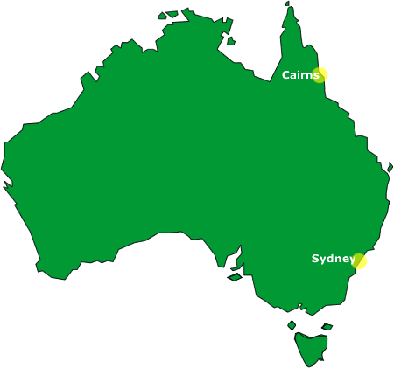

Slide 26
Cairns, Queensland
Tourism plays a major part in the Cairns economy
Fourth-most popular destination for international tourists in Australia after Sydney, Melbourne and Brisbane

Slide 27
The city is in close proximity to the Great Barrier Reef, the Wet Tropics of Queensland, and the Atherton Tableland.
Cairns esplanade includes a swimming lagoon with adjoining barbecue areas. In May 2003, the then Cairns Mayor Kevin Byrne declared that topless sunbathing is permitted here, as the area is a gathering point for people from around the world who may wish to do so.

Slide 28
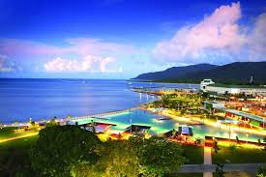

Slide 29
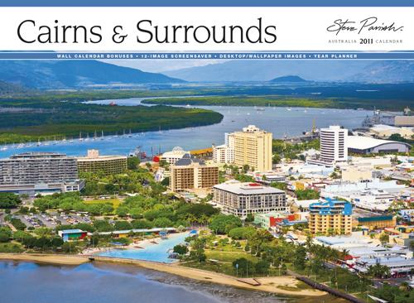

Slide 30
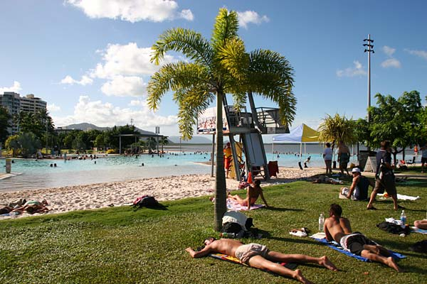

Slide 31
http://www.youtube.com/watch?v=CXwi4xqsJRo

