Slide 1
The Schengen Agreement
And its implications on tourism

Slide 2
What is Schengen?
The name "Schengen" originates from a small town in Luxembourg
In June 1985, seven European Union countries signed a treaty to end internal border checkpoints and controls
More countries have joined the treaty over the past years

Slide 3
What is Schengen?
There are now 25 European countries that are party to the Schengen Agreement, which eliminates all internal border controls between them
Once you enter one Schengen country you may travel continuously for up to 90 days within the member countries
Within the Schengen area, you do not show your passport when crossing country borders

Slide 4
Not the EU
All Schengen countries are in Europe. However, it should not be confused with the EU (European Union)
Schengen and European Union are two different agreements between European countries
Schengen includes all European Union countries (except Ireland and United Kingdom) and three non-EU members (Iceland, Norway, and Switzerland)

Slide 5
Member Countries
Austria
Belgium
Czech Republic
Denmark
Estonia
Finland
France
Germany
Greece
Hungary
Iceland
Italy
Latvia
Lithuania
Luxembourg
Malta
Netherlands
Norway
Poland
Portugal
Slovak Republic
Slovenia
Spain
Sweden
Switzerland

Slide 6
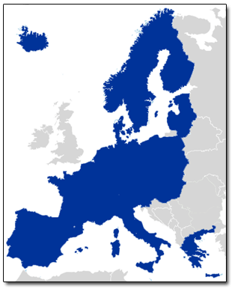

Slide 7
Schengen and Tourism
If you are traveling for business or tourism:
Canadians don’t need a visa for the initial entry into the Schengen area, but you must have a passport valid three months beyond the proposed stay.
Ex: for a two-week business trip, the passport must be valid for four months; for a two-month holiday the passport must be valid for five months.

Slide 8
Countries from which you do not need a visa to enter Europe:

Slide 9
Schengen and Tourism
Once you’ve been in the Schengen area for 90 days, you must leave and stay outside the area for 90 days before you can reenter without a visa
If you are traveling for reasons other than business or tourism (such as employment, study, internship, etc.) you may need to get a visa, depending on which countries you intend to visit

Slide 10
Watch out!
Although European Union regulations require that non-EU visitors obtain a stamp in their passports upon initial entry to a Schengen country, many borders are not staffed with officers carrying out this function
If you want to be sure your entry is properly documented, you must ask for a stamp at an official point of entry
Without the stamp, you may be questioned and asked to prove how long you have been staying in Schengen countries when you leave

