Slide 1
Travelling through Europe
Train vs Car vs Airplane

Slide 2
Intro
Due to the creation of the European Union; Europe has created a first class rail and road system.

Slide 3
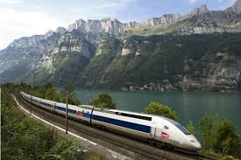
Train
The Train system is very popular as it is runs on time and very frequently
The newest trains are also among the world’s fastest (e.g. Amsterdam to Paris in 2hrs)
Fares have been kept to a reasonable level so people can afford to take it to work.

Slide 4
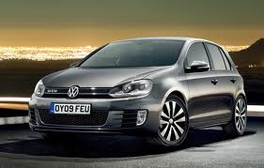
Auto
Gas(petro) are at least twice the price of what they are in Canada.
Traffic is worse as most European cities were developed to accommodate the horse & buggy.
Air pollution is a growing concern. Auto pollution is so heavy in some cities that its destroying historical buildings and statues.

Slide 5
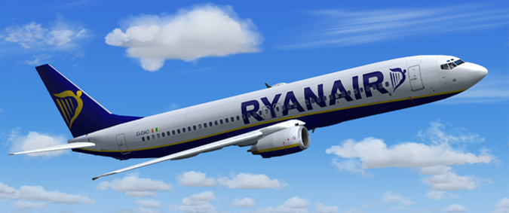
Airplane
Not a popular choice.
Most cities in Europe are not that far apart.
Handicapped due to NATO control over airspace = delays and diversions
Also national pride of most countries demands that they each have their own carrier. Therefore numerous airlines are competing for airspace

Slide 6
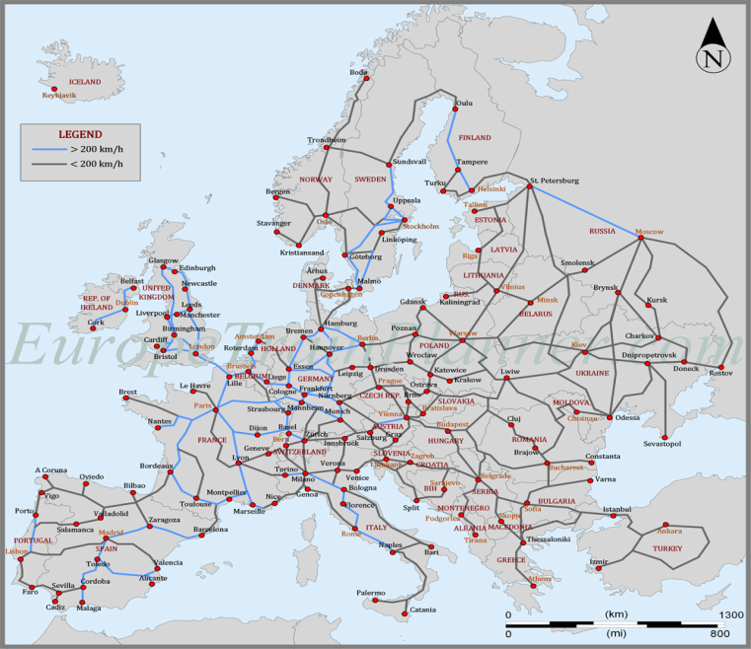
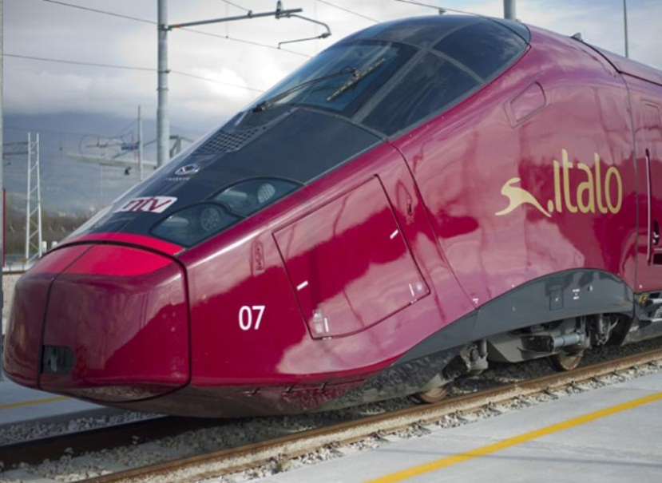
Results
Rail = the cheapest, most efficient and fastest city-to-city transportation for travelers and business people travelling in Europe.

Slide 7
Travelling by Train through Europe
Most countries offer a Pass (all inclusive days or number of days/trips) on National Rail Lines.
The Eurail pass lets you travel on trains run by the national train operators in up to 27 European countries.
Needs to be bought in Canada (outside Europe)
May include some ferries and sleeper trains
Does not include reservation fees

Slide 8
Travelling by Train
Riding the Rails
https://www.youtube.com/watch?v=3AxtbifeoBY&index=44&list=PL9oNoOc2PqteTyL9nUXRxfn7ObfqkJIyH
A Euro Rail Story
https://www.youtube.com/watch?v=HmHaWFRJ4JQ&list=PL9oNoOc2PqteTyL9nUXRxfn7ObfqkJIyH
Scheduling Spot overs
https://www.youtube.com/watch?v=sJ-ZQTEs-98&list=PL9oNoOc2PqteTyL9nUXRxfn7ObfqkJIyH

Slide 9
Chunnel
The first idea for a tunnel came in 1802. Was rejected due to technology. More recently, after WWII it was due to fears of national security.
Started building in 1988 and finished in 1994 at the cost of 4.6 Billion pounds
50km tunnel connecting Folkestone, Kent, in the United Kingdom, with Coquelles, Pas-de-Calais, near Calais in northern France, under the English Channel
Carries the high speed train ‘Eurostar’ for passengers and the ‘Eurotunnel Shuttle for cars and off road vehicles.

Slide 10
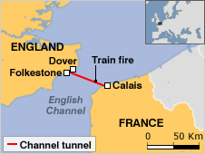
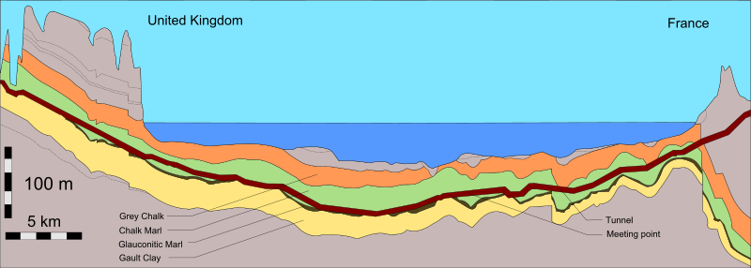

Slide 11
Videos
Inside the Euro Tunnel: Discovery Channelhttps://www.youtube.com/watch?v=kgwG4VWSkKA&list=PL9oNoOc2PqteTyL9nUXRxfn7ObfqkJIyH

Slide 12
Rick Steves – Travelling Through Europe Skills
Part 1 - https://www.youtube.com/watch?v=uz0UCZkPqbA&list=PL9oNoOc2PqteTyL9nUXRxfn7ObfqkJIyH
Part 2
https://www.youtube.com/watch?v=sZPjdzZ_9bQ&list=PL9oNoOc2PqteTyL9nUXRxfn7ObfqkJIyH
Part 3
https://www.youtube.com/watch?v=Zd6tgY681e4&list=PL9oNoOc2PqteTyL9nUXRxfn7ObfqkJIyH

