Slide 1
Types of Tourism

Slide 2
Business Tourism
Travel to Complete a business Transaction or event
Examples – conference/meeting

Slide 3
Nature Tourism
Travel to enjoy a natural setting, wildlife or scenery
E.g. Galapologs Islands

Slide 4
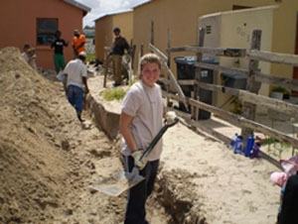
Voluntourism (Volunteer or working holiday)
Travelling to a destination to support a local community
E.g. building a school in Kenya

Slide 5
Ecotourism
A branch of Nature Tourism which involves the conservation of the environment
E.g Gorilla Trek in Uganda, Bird watching in Costa Rica

Slide 6
Cultural Tourism
Travel to enjoy the history and customs of a certain place or region
E.g. Eating pizza in Italy,

Slide 7
Adventure Tourism
involving exploration or travel to remote, exotic and possibly hostile areas
tourism involving activities that are physically challenging
E.g. Climbing Mt Killmanjero

Slide 8
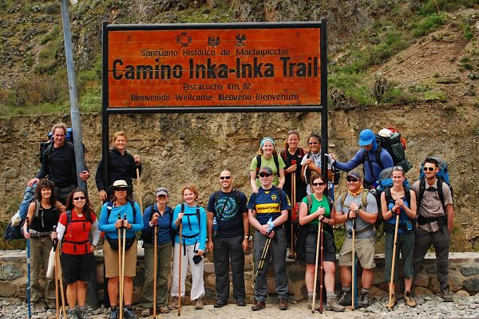
Active Tourism
A new travelling philosophy that combines adventure, ecotourism and cultural aspects of a discovery tour.
Active tourism is low-impact, ecological, socially compatible and high quality.
E.g. Hiking the Inca Trail

Slide 9
Social Tourism
Travel with Others
E.g Spa Weekend/Golf Trip/Spring Break Trip

Slide 10
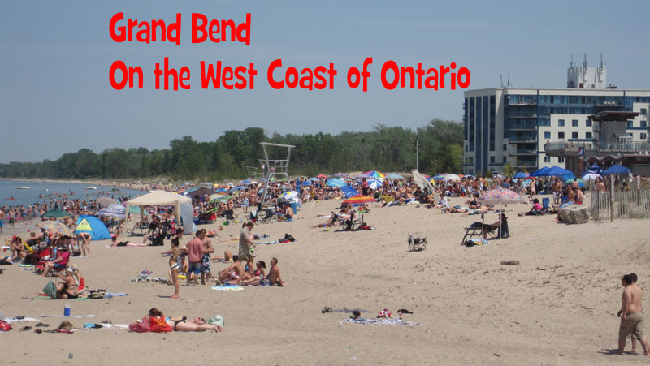
Recreation Tourism
Travel to experience something different than the daily routine (work)
E.g. Grand Bend, Sailing, concert

Slide 11
Sports Tourism
Travel to enjoy the participation or viewing of sports by amateurs and professionals.
E.g Olympics, NHL Winter Classic, World Cup

Slide 12
Religious Tourism
Travel to a spiritual place
E.g Mecca, Bethlehem

Slide 13
Health/Medical Tourism
Travel involving programs or activities to improve the physical or spiritual conditions of a person
E.g MS vein treatment in Costa Rica

Slide 14
Wilderness Tourism
Travel to enjoy a natural setting, wildlife or scenery in the remote wilderness.
E.g Canoe Trip in Algonquin for 4 days.

