Slide 1
Urban Land Use

Slide 2
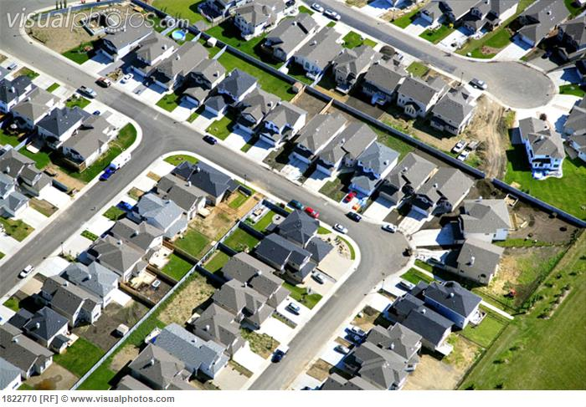
Residential
Includes all places where people live
Generally the largest land use in most cities often taking up to 40% or more of developed land
The most important characteristic is its density
Two factors influence residential density
Cost of land
Age of the neighborhood

Slide 3
Transportation
About 1/3 of developed land in most Canadian Cities is used for roads and highways
A cities transportation system is made up of 3 parts
Vehicles
Large amounts of traffic can create congestion on urban roads
Mass-transit systems are another alternative, but are very expensive. They only make sense in highly densely populated areas.
Travel Paths
Classified into 4 parts; expressways, arterial roads, local roads, collector roads.
Terminal Facilities
found at the end of a journey or transit line
May also include train stations, bus stations, airports, docks and other mass-transit stations.

Slide 4
Commercial
Types of Goods
Low Order – found everywhere (bread, milk)
Middle Order – willing to drive travel further for item (clothing, CD’s)
High Order – purchased infrequently and have a limited market (Porsche)
About 5% of a city’s land is for commercial goods.
Theses activities include the buying and selling of goods and services.

Slide 5
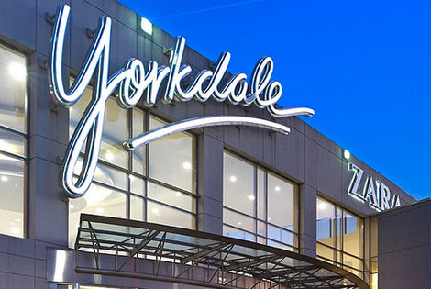
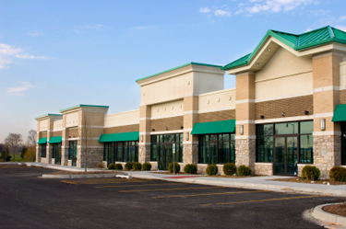
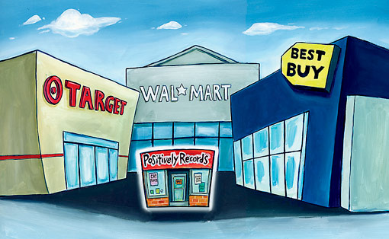
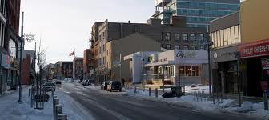
Commercial Con’t
There are 6 types of commercial land use
Local service centers
Neighborhood plazas and ribbons
Community shopping centers (malls)
Power Centers (big-box stores)
Regional Shopping Centers (Yorkdale)
Central Business District (Downtown)

Slide 6
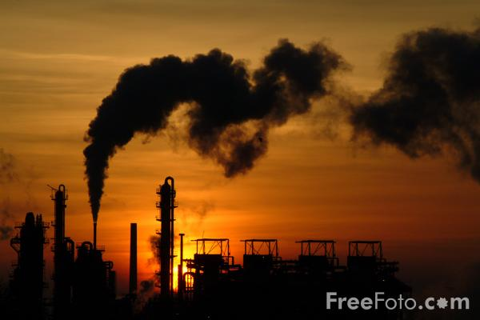
Industrial
On average about 6% of the developed land in most communities is used for industries such as factories.
Before the 1940’s, factories were built on land near waterfronts and railway lines.
After the 1940’s, better highways and long distance trucking have manufactures another alternative to shipping their goods.

Slide 7
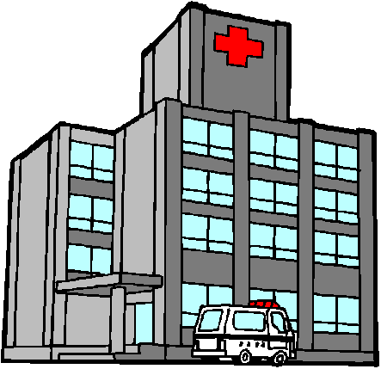
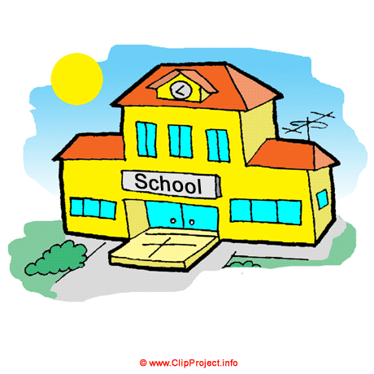
Institutional and Public Buildings
Such as School, Hospitals, City Hall and places of worship

Slide 8
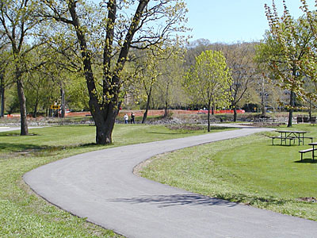
Recreational
Parks, playgrounds, playing fields, golf courses etc
Recreation is very important as it enhances your quality of life

Slide 9
Factors affecting Land Use

Slide 10
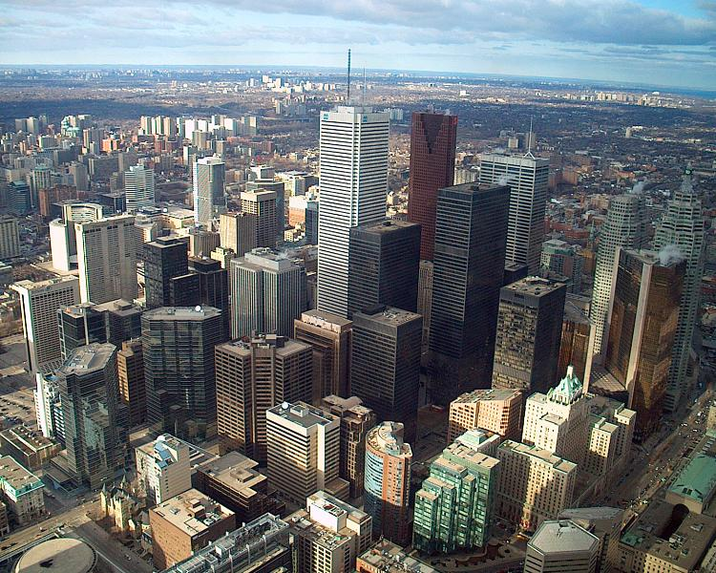
Land Value
Land values are the highest in areas of the city that are most accessible, such as the CBD and beside major transportation routes.
Large lot sizes are in high demand (Laurentian vs Activa)

Slide 11
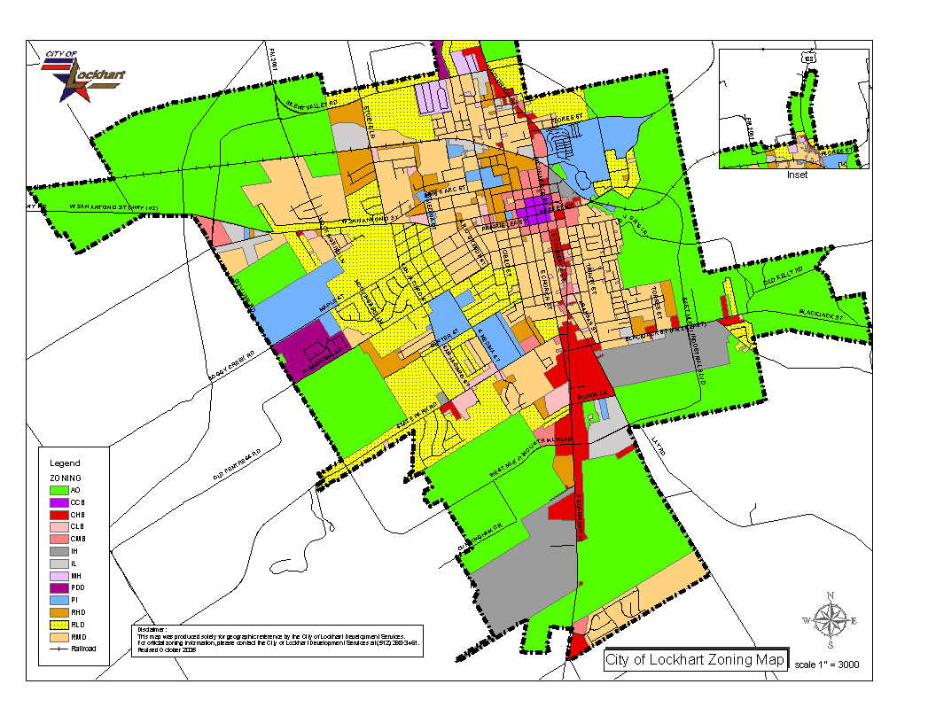
Zoning/Technology
Zoning refers to laws usually passed by city governments that control the kind and amount of development in an area
Technology
Land use patterns reflect the technology that existed when the land was developed (ie roads and parking)

Slide 12
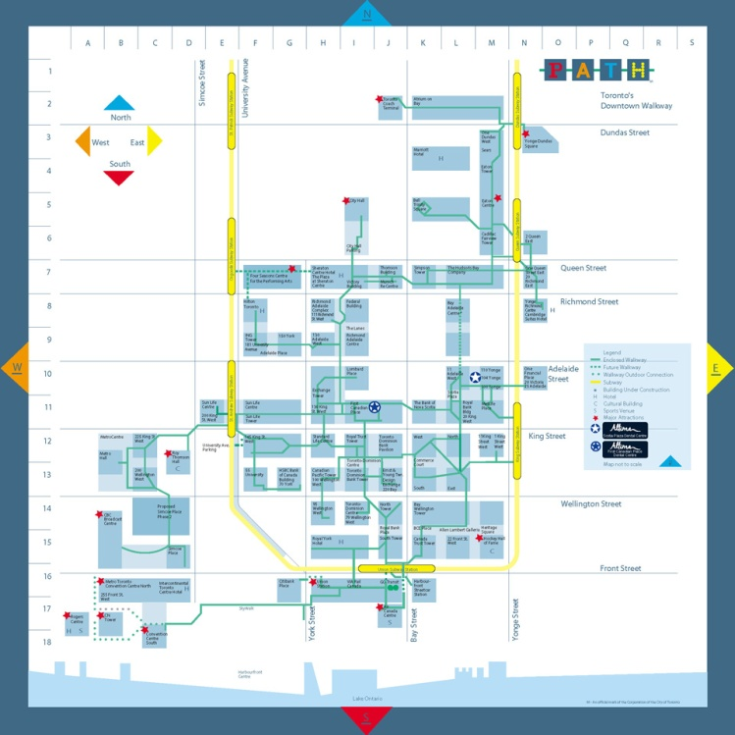
Climate
The winter city concept advocates the building of cities with inside and outside environments that are livable during long harsh winters
Many Canadian cities have built underground walkways in their downtown areas
Indoor shopping malls have been built
Bus Shelters, covered bridges etc

