Slide 1
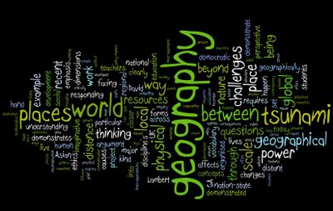
What is Geography?

Slide 2
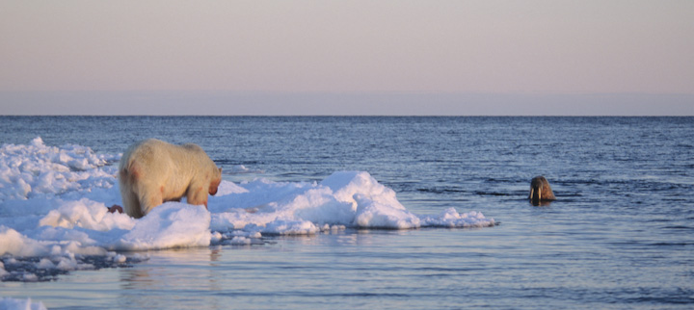
Geography is…
more a matter of CHALLENGES to THINK through than information to be remembered

Slide 3
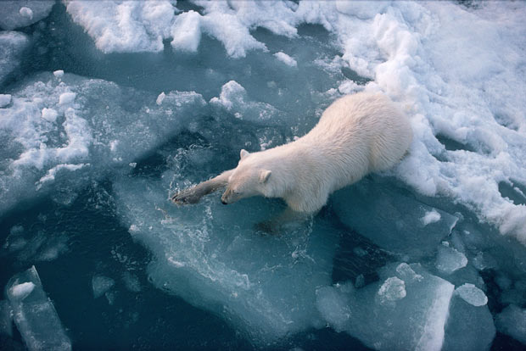
Geography is…
knowing where something is,
how its location influences its characteristics,
how its location influences relationships with other phenomena.
www.telegraph.co.uk

Slide 4
Geographic Thinking
Spatial significance
Interactions and associations
Patterns and trend
Value judgments
Evidence and interpretation
Geographic perspective

Slide 5
Spatial Significance
We must suspend our stereotypical view of a place.
importance of a place or region
the connections that exist between the geographical location and physical characteristics of a site
the unique relationships that exist in and between the natural and human environments in a particular place
the significance of the same place may be different for humans, animals, and plants
https://geoguessr.com

Slide 6
Patterns and trends
Pattern:
characteristics that are similar and that repeat themselves in a natural or human environment
Trend:
characteristics or traits that exhibit a consistent tendency in a particular setting over a period of time
Characteristics may be spatial, social, economic, physical, or environmental.
http://www.worldmapper.org/textindex/text_index.html

Slide 7
Interactions and associations
explore connections within and between natural and human environments.
the interconnected parts of an environment or environments work together to form a system
relationships that exist within a system and the relationships between systems in order to determine the impact they have on one another.
http://www.eduplace.com/geonet/geonet.html
(Click on the world, play Uses of Geography category…bottom right)

Slide 8
Geographic perspective
consider the
environmental,
economic,
political, and/or
social implications …
of the issues, events, developments, and/or phenomena
http://www.theglobeandmail.com

Slide 9
Evidence and interpretation
examine the accuracy, precision, and reliability of various data sources
http://gawker.com/israel-launches-series-of-airstrikes-kills-hamas-chief-1624345456
scrutinize the information found in various sources
https://www.youtube.com/watch?v=GXmaS1ZzpA8
http://www.statcan.gc.ca/daily-quotidien/140815/dq140815a-eng.htm
think carefully about the interpretations made from the available evidence
http://www.aljazeera.com

Slide 10
Value Judgments
what should happen and
what a possible positive future would look like.
Value judgments involve careful, fair-minded consideration of the advantages and disadvantages of options before reaching a conclusion
http://www.independent.co.uk/voices/comment/debate-should-ivory-stockpiles-be-destroyed-9099221.html

